Slide 1
Data Quality → Data Cleaning
Cost of bad data (IBM) = $3.1T/year in the US alone
Size of big data market (IDC) = $120B/year
To handle Data Quality issue, there are two kinds of approaches:
  Proactive/Preventive and/or Reactive/Reverse
September 12, 2019
MD Talk @ Beijing, China

Slide 2
A Database is Like a Lake
To ensure a clean lake, you must first eliminate
the sources of error
Prevention at source
Find and fix
Unmanaged
September 12, 2019
MD Talk @ Beijing, China

Slide 3


For Data, Only Two Moments Really Matter
Note that they DO NOT occur in IT
The Moment of Creation
The Moment of Use
PATH FROM CREATOR TO CUSTOMER
The whole point of data quality management is to connect the two!
DATA CREATOR
DATA CUSTOMER
September 12, 2019
MD Talk @ Beijing, China

Slide 4
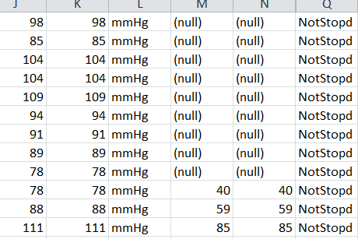
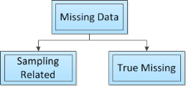
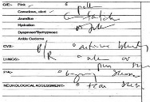

Data Quality Control: Electrical Health Record & Personal Health Record
Missing Data
Free Text in EHR
Four Types of Data:
-- Text Type Data
-- Quantitative Static
-- Quantitative Time Series
-- Quantitative Continuous data
Types of Missing data
Sampling Related
True Missing Data
Types of Missing Data
Missing Data in ICU
200,000-400,000 Medical Error Caused Death
[1] B. H. Hamilton, C. Y. Ko, K. Richards, and B. L. Hall. J. of the American College of Surgeons, vol. 210, no. 2, pp. 125–139. e2, 2010.
[2] C. Childs, A. L. C. Ng, K. Liu, and J. Pan. Brain Injury, vol. 25, no. 12, pp. 1163–1169, 2011.
September 12, 2019
MD Talk @ Beijing, China

Slide 5

DATA COLLECTION: ???? Capital
Many insights are derived from users’ personal financial data
Collection and accuracy of users’ financial data is a critical and central
component of our platform
Financial data collection methods are flawed and produce data sets containing
errors
BackendB has identified two data collection service providers (aggregators), ByAllAccounts (BAA) and Quovo
Screen Scraping vs API integrations
September 12, 2019
MD Talk @ Beijing, China

Slide 6
AGGREGATION
Quovo and ByAllAccounts (BAA) have been identified as best in class providers
Aggregators utilize users’ log in credentials to log into the users’ financial institution
and collect financial data
Two methods are used:API integrations and Screen Scraping
  API integration: Financial institution has API infrastructure built for aggregator companies to
integrate with and a clean feed of data is attainable. This method results in minimal errors
  Screen Scraping: When no APIs are available aggregator programmatically collect information from the client portal or website interface. This method results in a far higher frequency of errors.
Data is normalized after collection from the financial institution before delivery to
BackEndB. Normalization at the aggregator level still results in errors in data.
September 12, 2019
MD Talk @ Beijing, China

Slide 7
Step 1: User releases login credentials to BackEndB
BackEndB Personal Finance App Account Entry Screen
Step 2: User’s login credentials released to aggregator
Aggregator (Quovo or ByAllAccounts)
User of BackEndB
Step 3: Aggregator uses credentials to sign into financial institution website
Aggregator (Quovo or ByAllAccounts)
Step 5: Normalization Phase 1 occurs here, but resulting data still contains errors.
User’s
Financial Institution (Wells Fargo, Schwab, etc.)
Step 4: User’s financial data (holdings, transactions, etc.) collected through APIs or “screen scraping” technology flows from financial institution to aggregator
Step 6: Normalized data still containing errors is delivered to BackendB
BackEndB Normalization Engine
Step 7: Normalization Phase 2
Errors in the data coming from the aggregator will be corrected here so accurate reporting and analysis can be achieved. (capstone project)
BackEndB’s Portfolio Management System Once accurate data is in the portfolio management system, analysis and other functions can be performed
Step 8: Normalized, corrected, and accurate data is delivered to BackEndB’s portfolio management system
September 12, 2019
MD Talk @ Beijing, China

Slide 8
THE DATA
The data points we collect are:
  Transaction Date
  Transaction Amount
  Transaction Type
  Quantity
  Price
  Security Type
  Transaction Commission (if applicable)
  Fee Type and Amount
  Current Balance
  Length of account history obtained at first log in
The data sets we will provide will be:
  Quovo: This is the data set that comes directly from Quovo.
  ByAllAccounts:This is the data set of that comes directly from ByAllAccounts without any changes or corrections made.
  Portfolio Management System: Originates from BAA but is manually cleaned and corrected by us. This will serve as the control to compare with the other two data sets.
11
September 12, 2019
MD Talk @ Beijing, China

Slide 9
CAPSTONE PROJECT
Three Goals:
Determine which provider has the highest quality data between Quovo and BAA
Determine the feasibility of correcting the data
  First, determine the type, frequency, and predictability of errors in the data
  Second, write programming code to attempt to programmatically correct the data
Determine the feasibility of backing out advisor fees from the data. Can the fee taken by the advisor be accurately determined using only the financial data of the client?
12
September 12, 2019
MD Talk @ Beijing, China

Slide 10
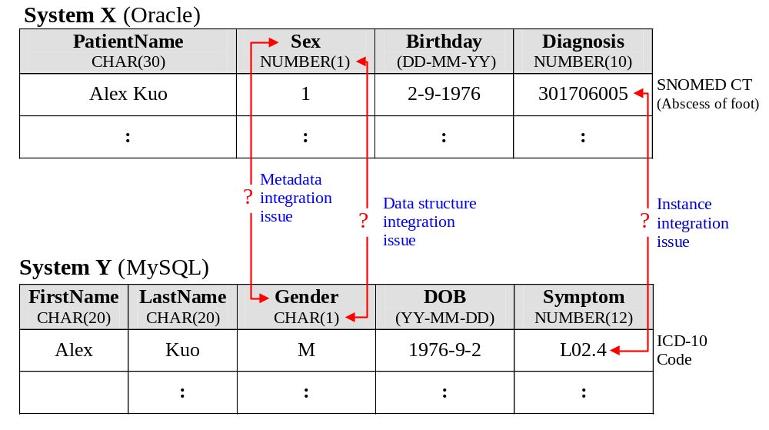

Metadata Integration Challenges
Each system use its own metadata to describe data.
September 12, 2019
Notes:
However, there are several challenges to the use of metadata for data management. The main challenge is that each system may use its own metadata vocabulary (element) to describe data. For example, system X used “Sex” to describe a patient’s sexuality, while system Y used “Gender”.

